Slide 1
The Big Question How Can I Find Out About Things?
What can I touch?
How do I feel things?

Slide 2
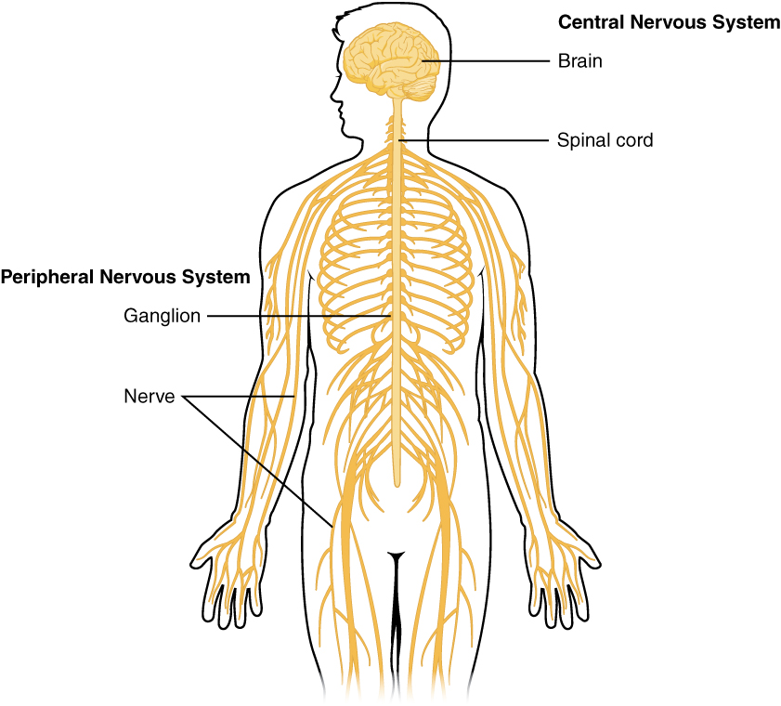
There are pathways running from just under your skin to your brain.
They look like this.
They send messages to your brain really quickly. This is important because it keeps you safe from hot and sharp things.

Slide 3
Experiment Find 5 things of different textures. Put a pillowcase over your head so you can’t see, Ask your grown-up or brother or sister to put 1 thing at a time in your hand. See if you can guess correctly what it is from the texture. Extension: See if you can guess what each thing is made from using your science knowledge from last week.

