Slide 1
ARCHITECTURE -EYFS and KS1

Slide 2
Close your eyes and imagine taking a walk from your home out into the streets around your home.
What places or things stand out? Everyone experiences their neighbourhood in their own way.
Go for a walk around where you live. Take photos on an i-pad or phone of things you see on your walk that you like. These may help you with ideas for your map.
Memory maps often mix drawings and words, and don’t need to be accurate. Think about the
sounds, colours, textures, and smells that are part of your experience as you walk around your neighbourhood.
Can you include these somehow? There is no “right way” to make a memory map.
Your map should reflect you and your unique view of your neighbourhood.
Once you have drawn you map, share a photograph of your creation on Instagram! Tag @centerforarchk12
and use #architectureathome.
Also, email your map to Ms Van Cook svancook@wellgreenprimary.co.uk

Slide 3
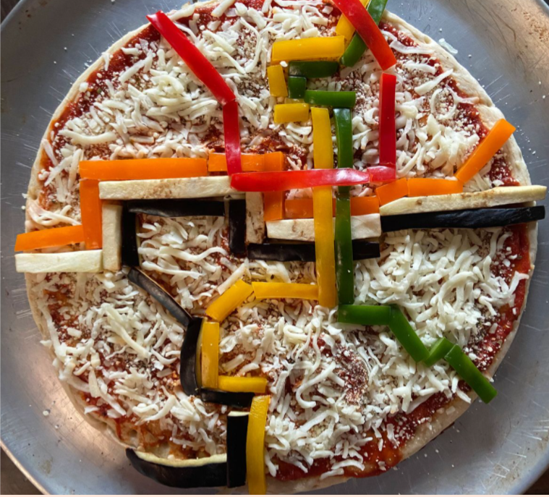
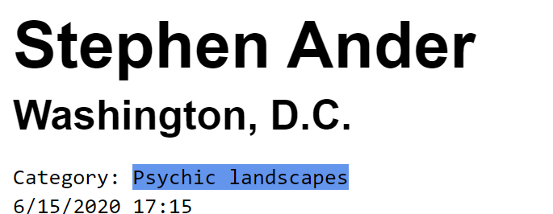
This man lives near the metro (a tram line) so he made a map of the tram map.

Slide 4
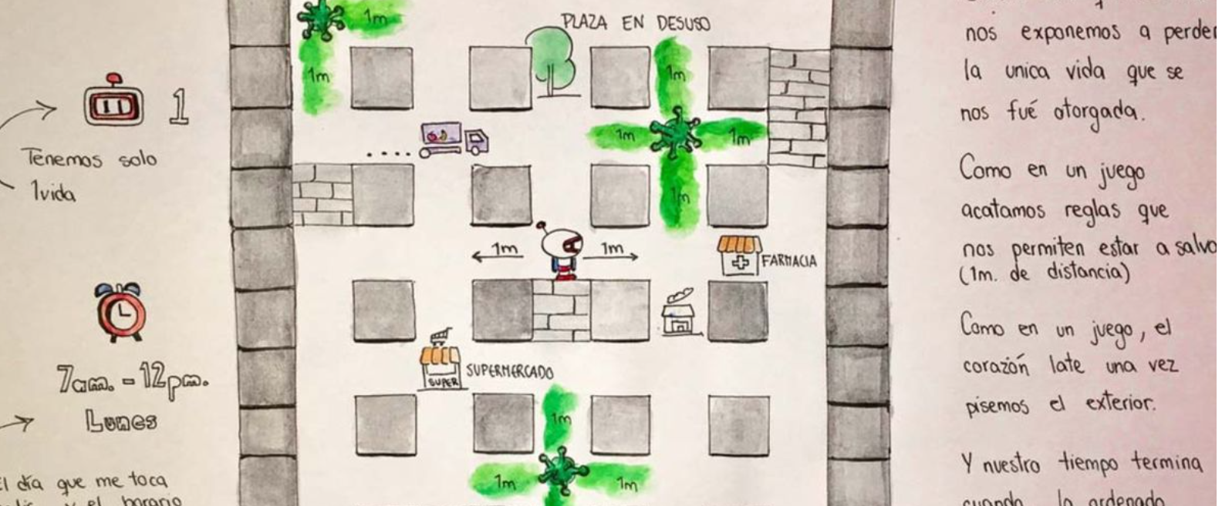
This person made a map of where she lived and mixed it with a game she liked playing.

Slide 5
‘We moved here in November and we've certainly been discovering every inch of it, walking it every day.’

